Slide 1
Lecture 03: 80X86 Microprocessor

Slide 2
The 80x86 IBM PC and Compatible Computers
Chapter 1
80X86 Microprocessor
Chapter 9.1
8088 Microprocessor

Slide 3
Evolution of 80X86 Family
8086, born in 1978
  First 16-bit microprocessor
  20-bit address data bus, i.e. 2²⁰ = 1MB memroy
  First pipelined microprocessor
8088
  Data bus: 16-bit internal, 8-bit external
  Fit in 8-bit world, e.g., motherboard, peripherals
  Adopted in the IBM PC + MS-DOS open system
80286, 80386, 80486
  Real/protected modes
  Virtual memory

Slide 4
Internal Structure of 8086
Two sections
  Bus interface unit (BIU): accesses memory and peripherals
  Execution unit (EU): executes instructions previously fetched
  Work simultaneously

Slide 5
Internal Structure of 8086

Slide 6
Bus Interface Unit
Take in charge of data transfer between CPU and memory and I/O devices as well
  Instruction fetch, instruction queuing, operand fetch and storage, address relocation and Bus control
Consists of :
  four 16-bit segment registers: CS, DS, ES, SS
  One 16-bit instruction pointer: IP
  One 20-bit address adder: CS left-shifted by 4 bits + IP (CS*16+IP)
  A 6-byte instruction queue
While the EU is executing an instruction, the BIU will fetch the next one or several instructions from the memory and put in the queue

Slide 7
Execution Unit
Take in charge of instruction execution
Consists of:
  Four 16-bit general registers: Accumulator (AX), Base (BX), Count (CX) and Data (DX)
  Two 16-bit pointer registers: Stack Pointer (SP), Base Pointer (BP)
  Two 16-bit index registers: Source Index (SI) and Destination Index (DI)
  One 16-bit flag register: 9 of the 16 bits are used
  ALU

Slide 8
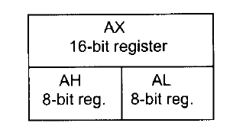

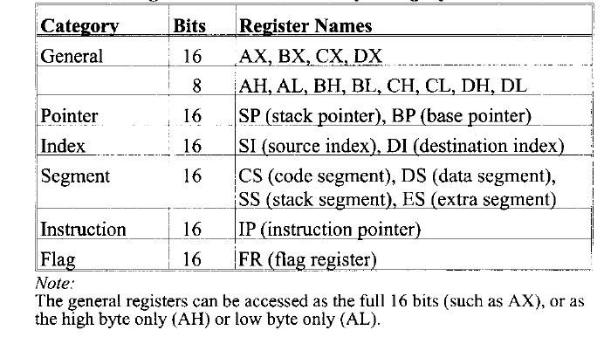
Registers
On-chip storage: super fast & expensive
Store information temporarily
Six groups

Slide 9

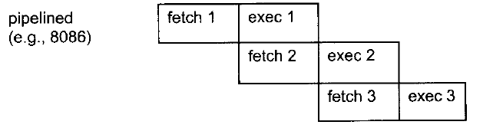
Pipelining in 8086
BIU fetches and stores instructions once the queue has more than 2 empty bytes
EU consumes instructions pre-fetched and stored in the queue at the same time
Increases the efficiency of CPU
When it works?
  Sequential instruction execution
  Branch penalty: when jump instruction executed, all pre-fetched instructions are discarded

Slide 10
8086/8088 Pins (Compare them and tell the difference)

Slide 11
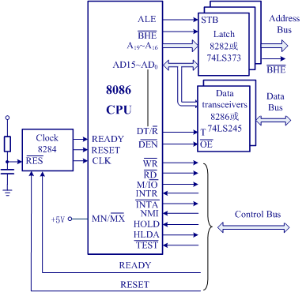
Minimum Mode Configuration
8086/88’s two work modes:
Minimum mode： =1
  Single CPU;
  Control signals from the CPU
Maximum mode： =0
  Multiple CPUs(8086+8087)
  8288 control chip supports

Slide 12
Control Signals
MN/~MX: Minimum mode (high level), Maximum mode (low level)
~RD: output, CPU is reading from memory or IO
~WR: output, CPU is writing to memory or IO
M/~IO: output, CPU is accessing memory (high level) or IO (low level)
READY: input, memory/IO is ready for data transfer
~DEN: output, used to enable the data transceivers
DT/~R: output, used to inform the data transceivers the direction of data transfer, i.e., sending data (high level) or receiving data (low level)
~BHE: output, ~BHE=0, AD8-AD15; ~BHE=1, AD0-AD7
ALE: output, used as the latch enable signal of the address latch

Slide 13
Control Signals
HOLD: input signal, hold the bus request
HLDA: output signal, hold request ack
INTR: input, interrupt request from 8259 interrupt controller, maskable by clearing the IF in the flag register
INTA: output, interrupt ack
NMI: input, non-maskable interrupt, CPU is interrupted after finishing the current instruction; cannot be masked by software
RESET: input signal, reset the CPU
  IP, DS, SS, ES and the instruction queue are cleared
  CS = FFFFH
  What is the address of the first instruction that the CPU will execute after reset?
Notes:
H represents hexadecimal numbers

Slide 14
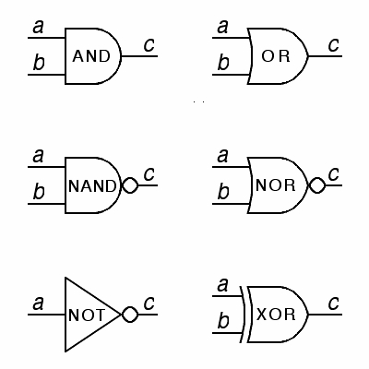
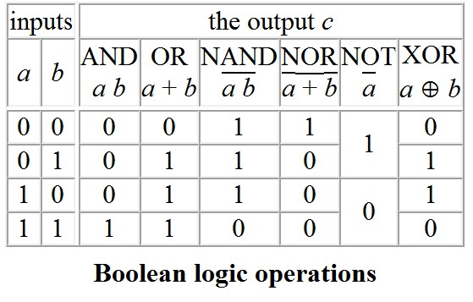
Remember CMOS Gates?

Slide 15
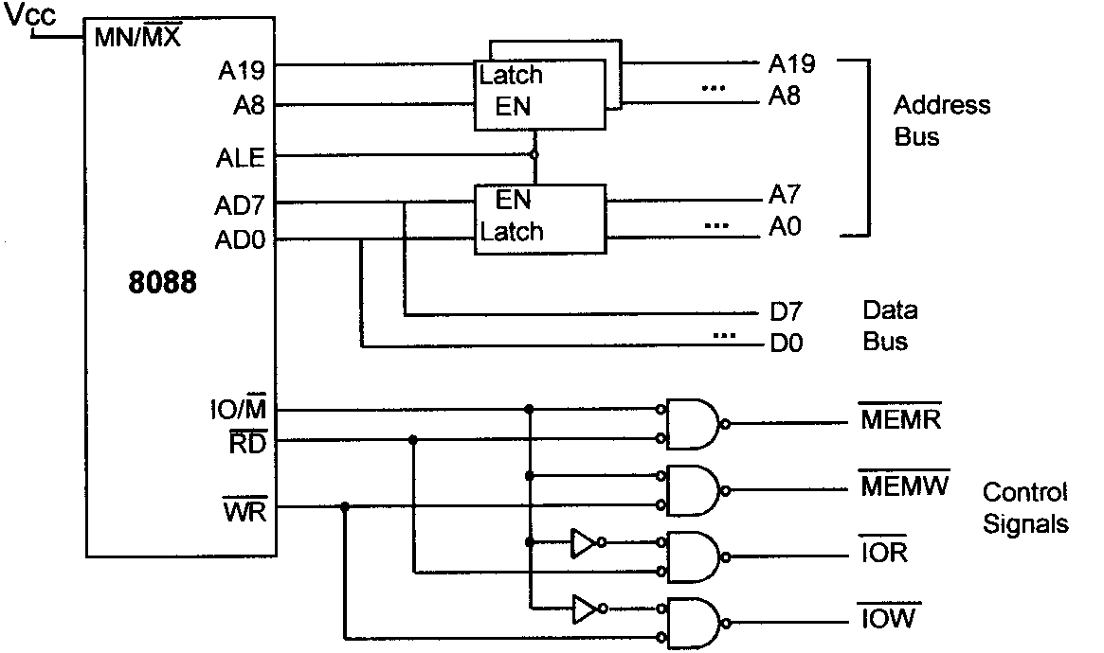
Memory/IO Control Signals

Slide 16
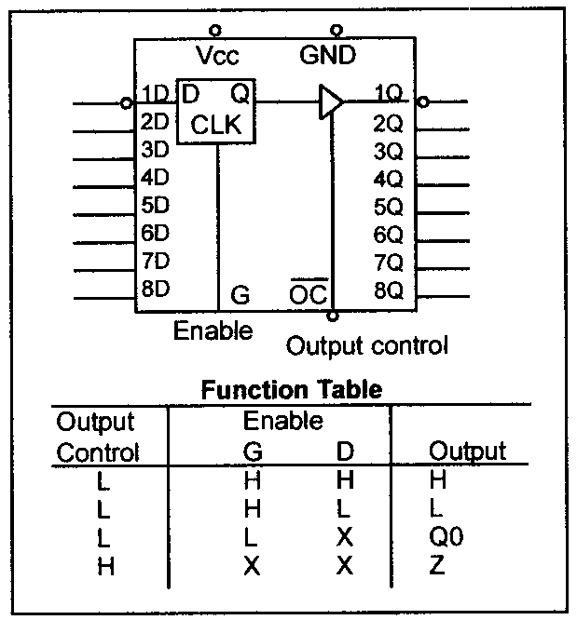

Address/Data Demultiplexing & Address latching
Notes:
Z represent the high-impedance state

Slide 17
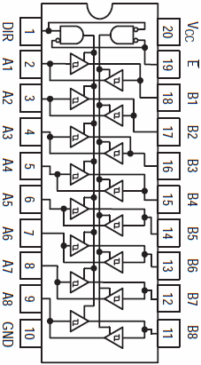
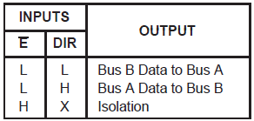
Data Bus Transceiver

Slide 18
8086/88 Bus Cycle (for data transfers)
At least 4 clock cycles
T1：
T2:
T3:
T4:
Tw:

Slide 19
8086 Programming
A typical program on 8086 consists of at least three segments
  code segment: contains instructions that accomplish certain tasks
  data segment: stores information to be processed
  stack segment: store information temporarily
What is a segment?
  A memory block includes up to 64KB
    Why? Upward compatibility, 8085 has 16-bit address bus
  Begins on an address evenly divisible by 16
    i.e., an address ends in 0H
    Why? (See later)

Slide 20
Logical & Physical Address
Physical address
  20-bit address that is actually put on the address bus
  A range of 1MB from 00000H to FFFFFH
  Actual physical location in memory
Logical address
  Consists of a segment value (determines the beginning of a segment) and an offset address (a location within a 64KB segment)
  E.g., an instruction in the code segment has a logical address in the form of CS (code segment register):IP (instruction pointer)

Slide 21

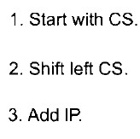
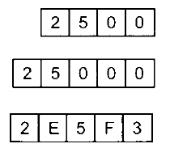
Logical & Physical Address
logical address -> physical address
  Shift the segment value left one hex digit (or 4 bits)
  Then adding the above value to the offset address
  One logical -> only one physical
Segment range representation
  Maximum 64KB
  logical 2500:0000 – 2500:FFFF
  Physical 25000H – 34FFFH (25000 + FFFF)

Slide 22
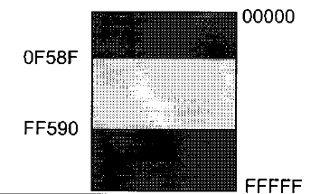
Physical Address Wrap-around
When adding the offset to the shifted segment value results in an address beyond the maximum value FFFFFH
E.g., what is the range of physical addresses if CS=FF59H?
  Solution:
  The low range is FF590H, and
  the range goes to FFFFFH and
  wraps around from 00000H to
  0F58FH (FF590+FFFF).

Slide 23
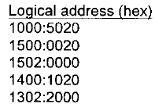
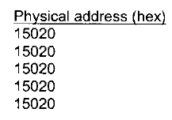
Logical & Physical Address
Physical address -> logical address ?
  One physical address can be derived from different logical addresses
  E.g.,

Slide 24
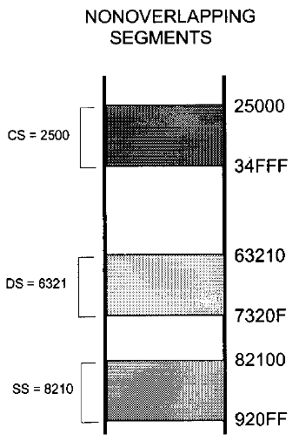
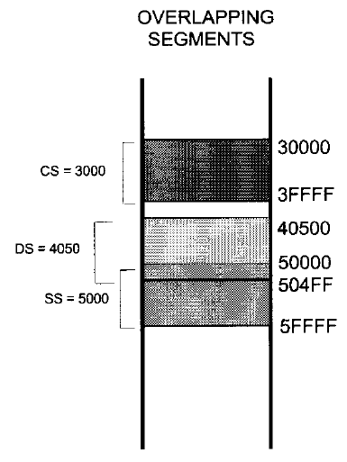
Segment Overlapping
Two segments can overlap
  Dynamic behaviour of the segment and offset concept
  May be desirable in some circumstances

Slide 25
Code Segment
8086 fetches instructions from the code segment
  Logical address of an instruction: CS:IP
  Physical address is generated to retrieve this instruction from memory
  What if desired instructions are physically located beyond the current code segment?
  Solution: Change the CS value so that those instructions can be located using new logical addresses

Slide 26
Data Segment
Information to be processed is stored in the data segment
  Logical address of a piece of data: DS:offset
    Offset value: e.g., 0000H, 23FFH
    Offset registers for data segment: BX, SI and DI
  Physical address is generated to retrieve data (8-bit or 16-bit) from memory
  What if desired data are physically located beyond the current data segment?
  Solution: Change the DS value so that those data can be located using new logical addresses

Slide 27
Data Representation in Memory
Memory can be logically imagine as a consecutive block of bytes
How to store data whose size is larger than a byte?
  Little endian: the low byte of the data goes to the low memory location
  Big endian: the high byte of the data goes to the low memory location
  E.g., 2738H

Slide 28
Stack Segment
A section of RAM memory used by the CPU to store information temporarily
  Logical address of a piece of data: SS:SP (special applications with BP)
  Most registers (except segment registers and SP) inside the CPU can be stored in the stack and brought back into the CPU from the stack using push and pop, respectively
  Grows downward from upper addresses to lower addresses in the memory allocated for a program
    Why? To protect other programs from destruction
    Note: Ensure that the code section and stack section would not write over each other

Slide 29
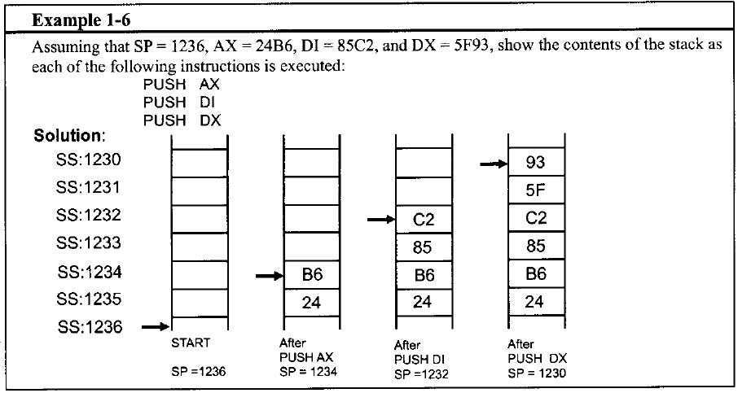
Push & Pop
16-bit operation
Little endian or big endian?

Slide 30
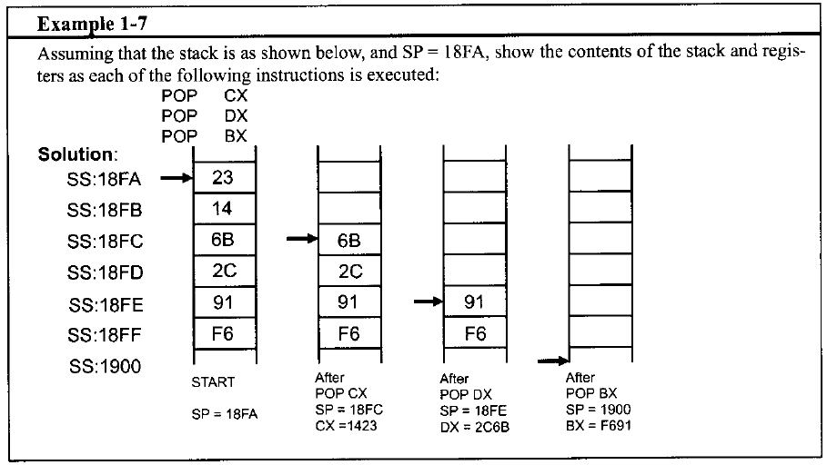
Push & Pop

Slide 31
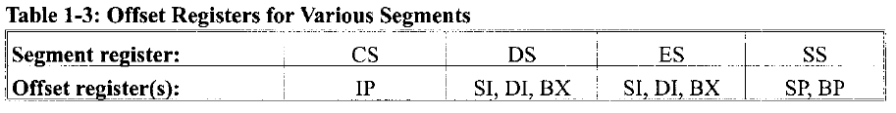
Extra Segment
An extra data segment, essential for string operations
  Logical address of a piece of data: ES:offset
    Offset value: e.g., 0000H, 23FFH
    Offset registers for data segment: BX, SI and DI
In Summary,

Slide 32
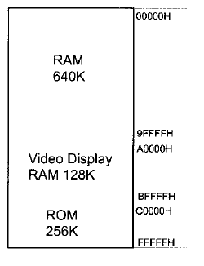
Memory map of the IBM PC
1MB logical address space
640K max RAM
  In 1980s, 64kB-256KB
  MS-DOS, application software
  DOS does memory management; you do not set CS, DS and SS
Video display RAM
ROM
  64KB BIOS
  Various adapter cards

Slide 33
BIOS Function
Basic input-output system (BIOS)
  Tests all devices connected to the PC when powered on and reports errors if any
  Load DOS from disk into RAM
  Hand over control of the PC to DOS

Slide 34
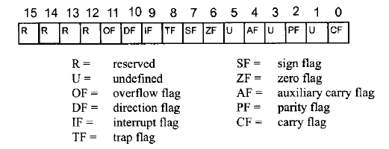
Flag Register
16-bit, status register, processor status word (PSW)
6 conditional flags
  CF, PF, AF, ZF, SF, and OF
3 control flags
  DF, IF, TF

Slide 35
Conditional Flags
CF (Carry Flag): set whenever there is a carry out, from d7 after a 8-bit op, from d15 after a 16-bit op
PF (Parity Flag): the parity of the op result’s low-order byte, set when the byte has an even number of 1s
AF (Auxiliary Carry Flag): set if there is a carry from d3 to d4, used by BCD-related arithmetic
ZF (Zero Flag): set when the result is zero
SF (Sign Flag): copied from the sign bit (the most significant bit) after op
OF (Overflow Flag): set when the result of a signed number operation is too large, causing the sign bit error

Slide 36

More about Signed Number, CF&OF
The most significant bit (MSB) as sign bit, the rest of bits as magnitude
  For negative numbers, D7 is 1, but the magnitude is the represented in 2’s complement
CF is used to detect errors in unsigned arithmetic operations
OF is used to detect errors in signed arithmetic operations
  E.g., for 8-bit ops, OF is set when there is a carry from d6 to d7 or from d7 out, but not both

Slide 37

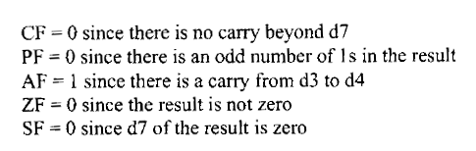



Examples of Conditional Flags
OF = 0 since there is no carry from d6 to d7 and no carry beyond d7
Notes:
In CPU, we have an adder circuitry but no subtractor circuitry so when doing subtraction x-y, we add x to the 2’s complement of y.
What’s 2’s complement of a binary number? Invert all bits and then add 1 to the result.

Slide 38
Control Flags
IF (Interrupt Flag): set or cleared to enable or disable only the external maskable interrupt requests
  After reset, all flags are cleared which means you (as a programmer) have to set IF in your program if allow INTR.
DF (Direction Flag): indicates the direction of string operations
TF (Trap Flag): when set it allows the program to single-step, meaning to execute one instruction at a time for debugging purposes

Slide 39
80X86 Addressing Modes
How CPU can access operands (data)
80X86 has seven distinct addressing modes
  Register
  Immediate
  Direct
  Register indirect
  Based relative
  Indexed relative
  Based indexed relative
MOV instruction
  MOV destination, source

Slide 40
Register Addressing Mode
Data are held within registers
  No need to access memory
  E.g.,

Slide 41

Immediate Addressing Mode
The source operand is a constant
  Embedded in instructions
  No need to access memory
  E.g.,

Slide 42
Direct Addressing Mode
Data is stored in memory and the address is given in instructions
  Offset address in the data segment (DS) by default
  Need to access memory to gain the data
  E.g.,

Slide 43
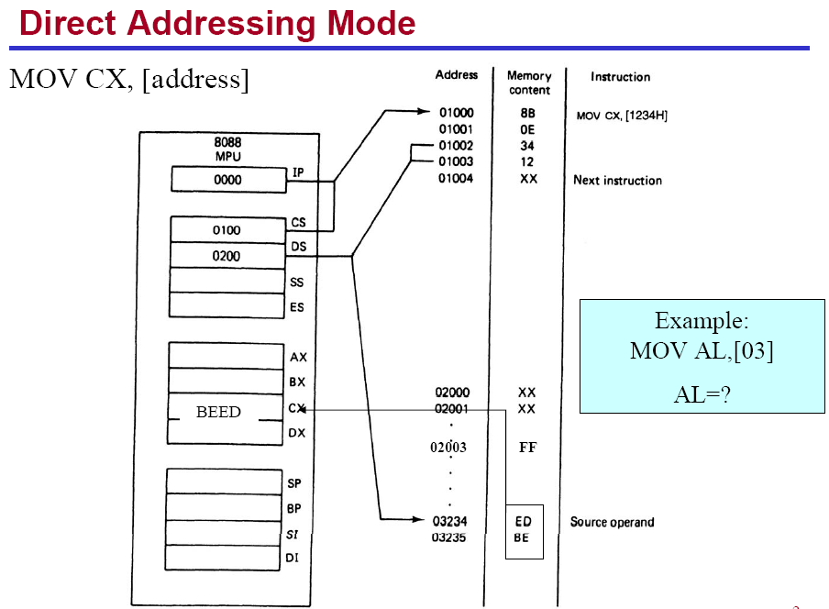

Slide 44
Register Indirect Addressing Mode
Data is stored in memory and the address is held by a register
  Offset address in the data segment (DS) by default
  Registers for this purpose are SI, DI, and BX
  Need to access memory to gain the data
  E.g.,

Slide 45
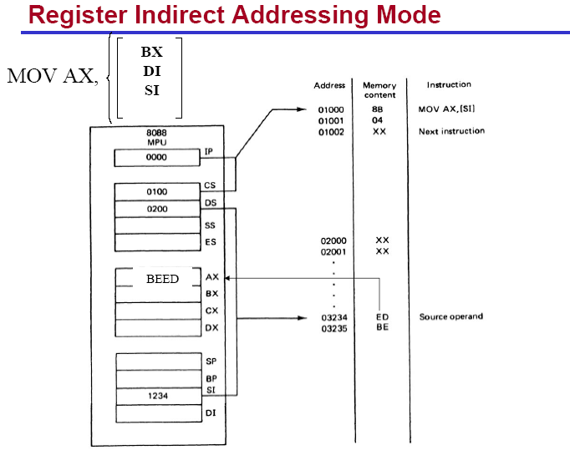

Slide 46
Based Relative Addressing Mode
Data is stored in memory and the address can be calculated with base registers BX and BP as well as a displacement value
  The default segment is data segment (DS) for BX, stack segment (SS) for BP
  Need to access memory to gain the data
  E.g.,

Slide 47
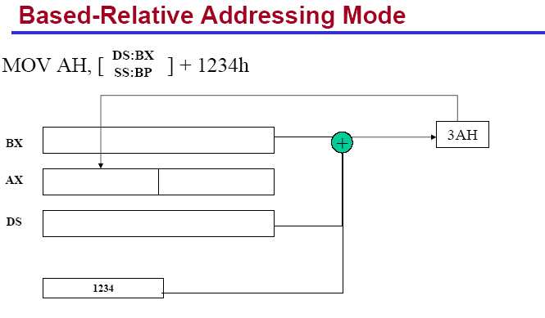

Slide 48

Indexed Relative Addressing Mode
Data is stored in memory and the address can be calculated with index registers DI and SI as well as a displacement value
  The default segment is data segment (DS)
  Need to access memory to gain the data
  E.g.,

Slide 49
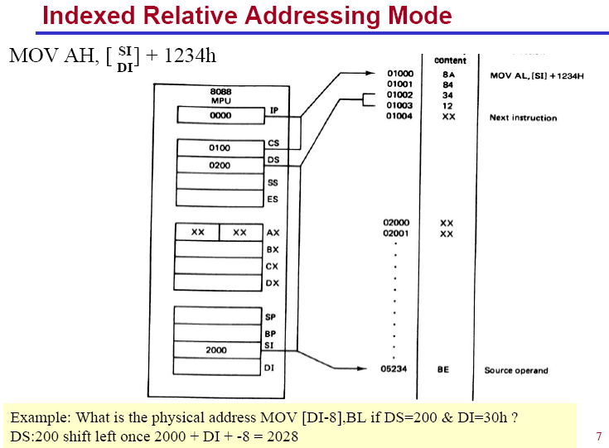

Slide 50

Based Indexed Addressing Mode
Combines based and indexed addressing modes, one base register and one index register are used
  The default segment is data segment (DS) for BX, stack segment (SS) for BP
  Need to access memory to gain the data
  E.g.,

Slide 51
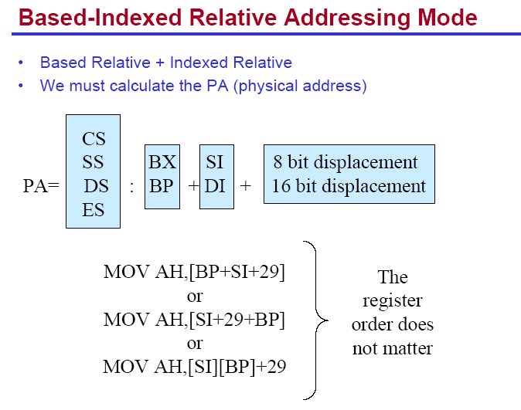

Slide 52
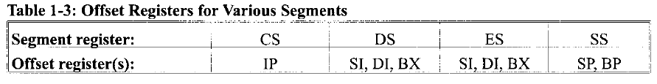
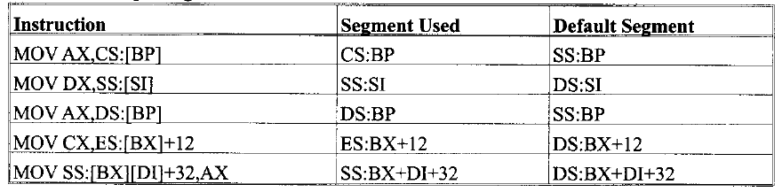
Segment Overrides
Offset registers are used with default segment registers
80X86 allows the program to override the default segment registers
  Specify the segment register in the code

